Slide 1

Farm Themed
Christmas Card Competition
Creative Crew

Slide 2


Design a Christmas Card with a farming theme!
Farmer's
Union
Wales

Slide 3

Key Information
Win a £30 Argos voucher for yourself and £50 for your school!
If you wish to enter this competition your entry must be handed in by Wednesday 20th October!

Slide 4
Your design has got to be on A4 paper.
Your paper can be landscape or portrait.

Slide 5
You can use:
Crayons
Coloured pencils
Felt tipped pens
Paint
to add colour to your design!

Slide 6
You must be between the ages of 4 and 11 years old to enter this competition – so that’s anyone from Reception to Year 6!

Slide 7
You must remember to put your:
Name
Age
Year Group
School
On the back of your design in pencil!

Slide 8
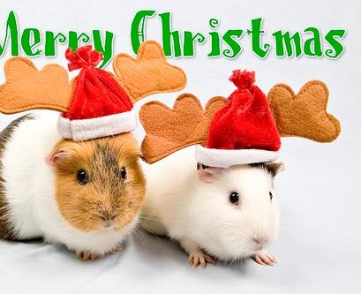
Hand in entries to Miss Evans or any member of the Creative Crew by Wednesday 20th October!
GOOD LUCK!

