Slide 1

Creative Crew Christmas Art Competition!
Have some fun and develop your artistic skills at the same time!

Slide 2
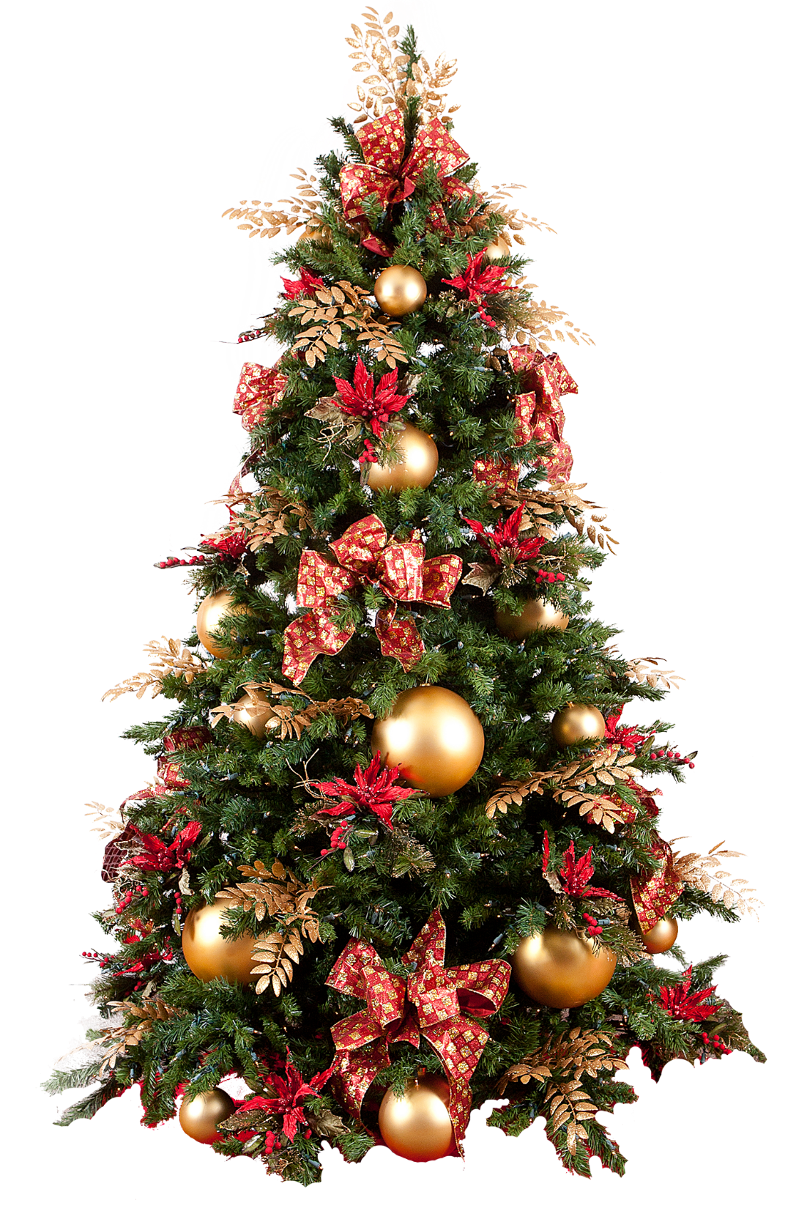
The Creative Crew would love you to design a beautiful Christmas tree!

Slide 3
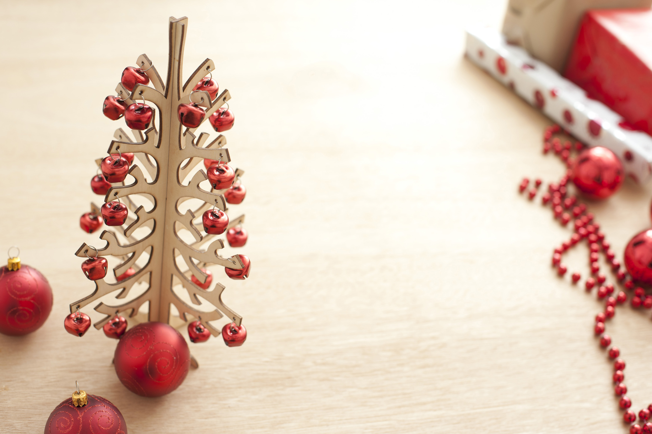
There will be winners from Foundation Phase and Key Stage 2!

Slide 4

Your design must be no bigger than A4!

Slide 5

You can use anything you like to make your design look amazing!
Remember lots of colour!

Slide 6

There are exciting prizes to be won!

Slide 7

Please give your entry to Miss Evans or a member of the Creative Crew by Monday 13th December!

Slide 8

Make sure you write your name and class on the back of your entry!

Slide 9
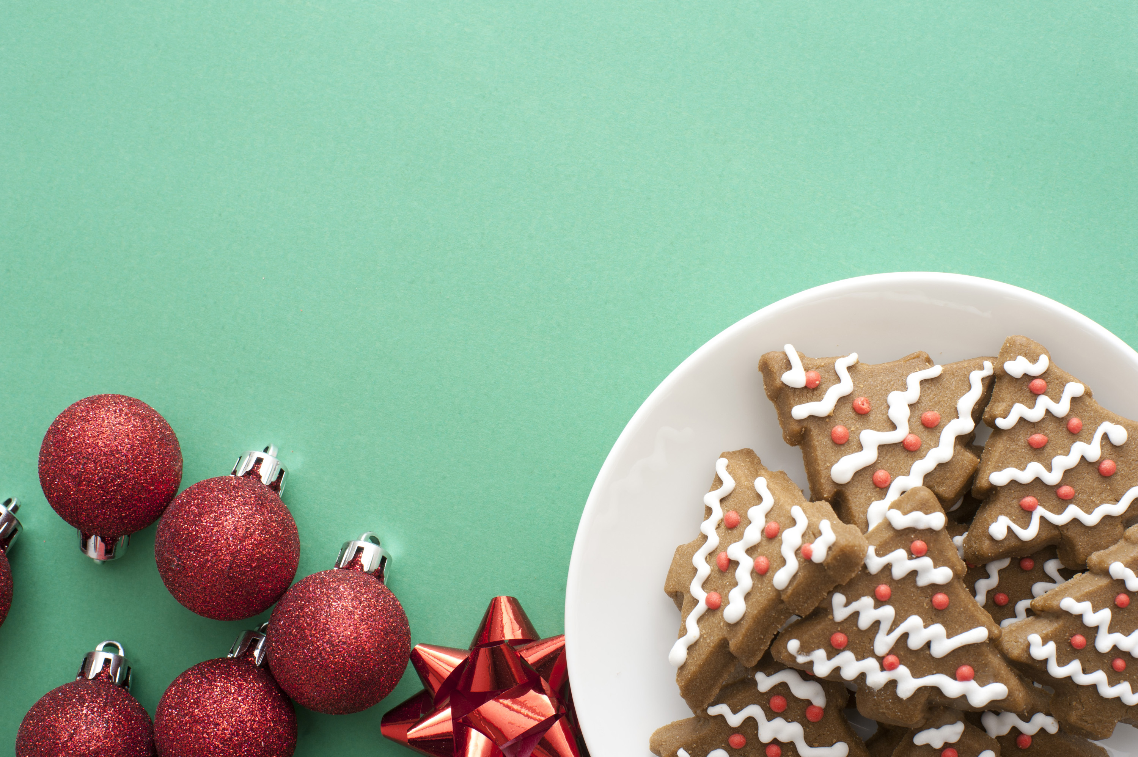
Good luck and Merry Christmas!
From the Creative Crew!

