Slide 1

Catfishing
By Noah

Slide 2

Catfishing: What does it mean?
Catfishing* means someone on the internet pretends to be other people. They do this to get personal info.
(*Not to be confused with the animal Catfish.)

Slide 3
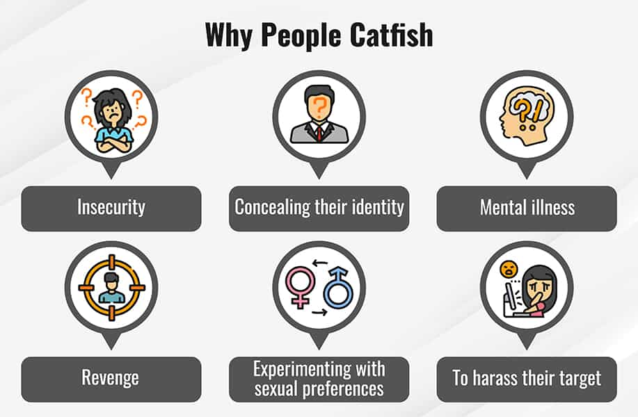
Why do people Catfish?
People Catfish because they often feel lonely.
This pic explains.
People do it to take personal info such as your name, age, etc.
They will also occasionally ask for money.

Slide 4

What should I do?
You may think the person is real, but it is a fake!
If you might not know if it's them, call them!
If it isn't the person, block and report them.

Slide 5
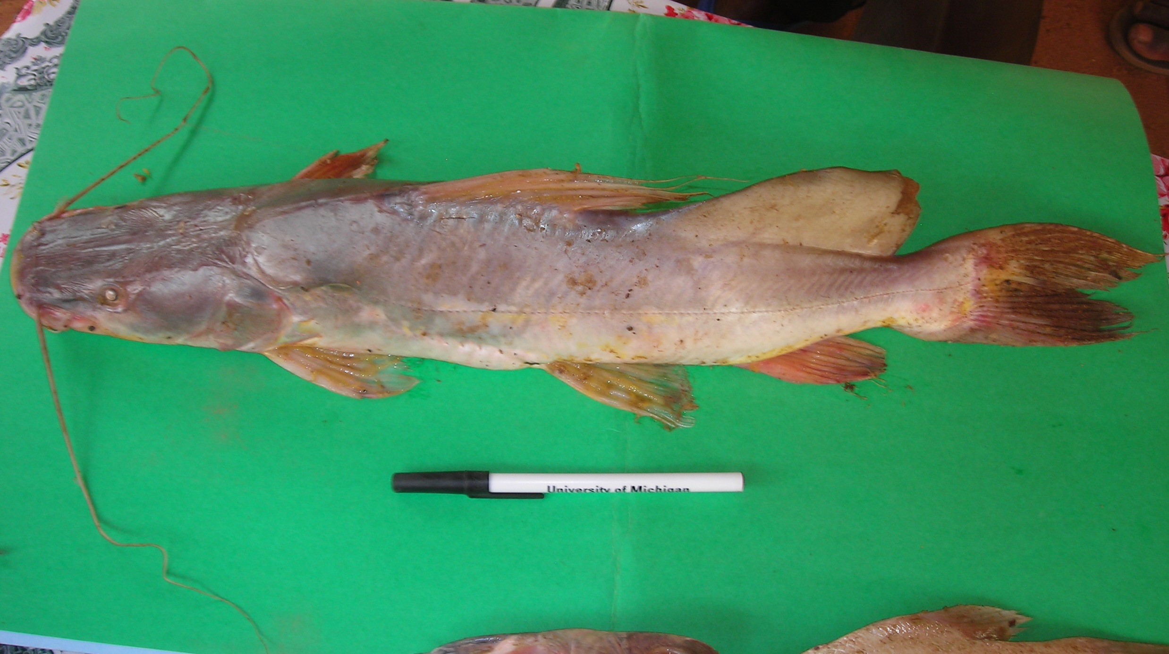
Where did the term "Catfish" come from?
Catfish are also a type of fish.
Catfish are an important group because they serve many different roles, including as ornamentals , as food fish in aquaculture, as research animals, and for sport fishing. Most catfish are found in freshwater, although there are two families that contain saltwater species.
The term “catfish” came from the 2010 documentary of the same name, which looked at the phenomenon of people creating false identities online. The term has since come to mean someone who creates a false identity online to deceive another person, often for romantic or financial gain.

Slide 6

What to do if you're being Catfished
Stop talking to the person.
Immediately report and block the account.
Get off the app.

Slide 7

Never ever....
Never give your password away.
Never tell your name, DON'T use it as your username.
Never tell where you go to school.
Don't even think of giving away your home address.
Don't say/show (if you have a webcam) your credit card numbers, etc.

