Slide 1


Catfishing
by layla cannon

Slide 2


What is catfishing?
Catfishing is when someone pretends to be someone else online.
You may think you know them, but it is actually a stranger on the other side of the laptop, iPad or phone. Anyone could be a catfish, they could be a really bad person, that may want to feel in control, steal personal information or get your money .

Slide 3


How do you avoid catfishing?
To avoid catfishing just block the user and then report them so they cannot steal anything off you or do anything bad to you .

Slide 4

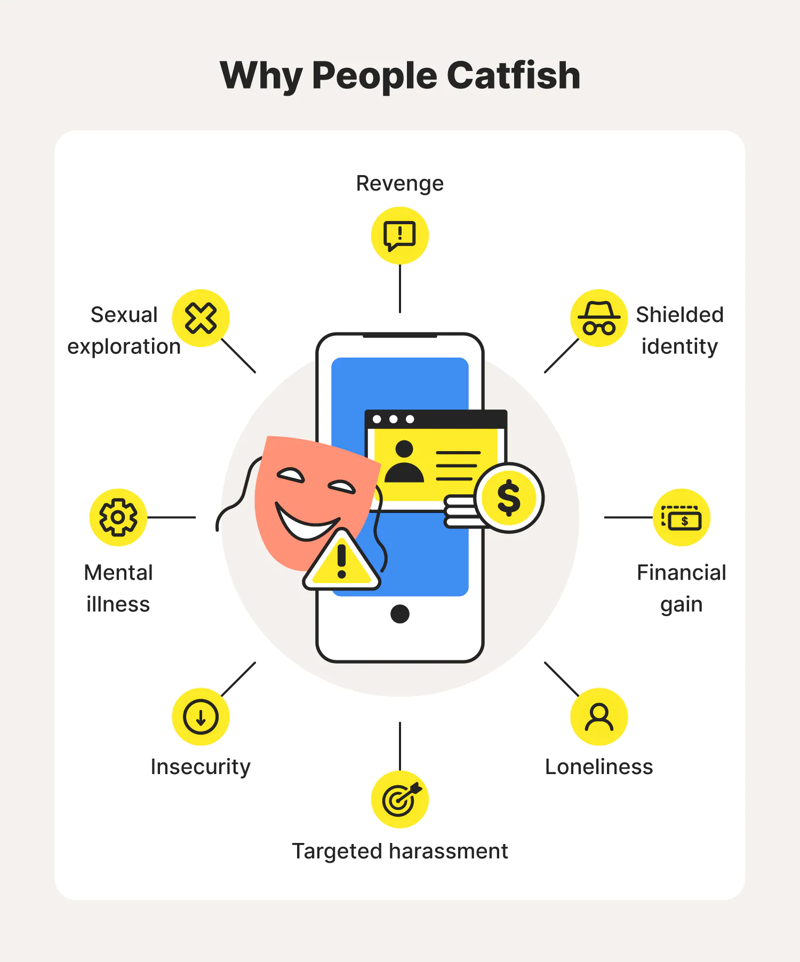
Why do people catfish ?
People are just really bad and want to get other people belongings or money and just think that it's good to catfish but it really not.
Some reasons for why people might catfish are:

Slide 5

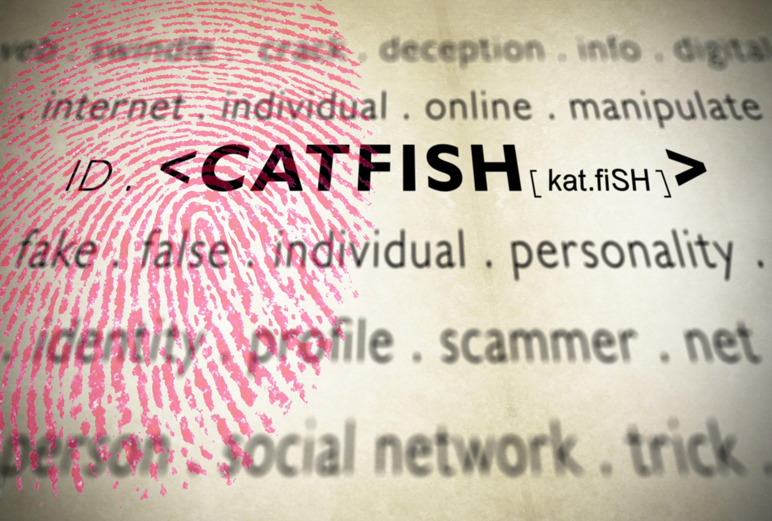
How people catfish ?
People can get information for any social media and get photos of people that are other people's friends and then pretend to be them.
They could catfish people by pretending to be a close friend of someone and maybe saying "I'm running low on money; can you transfer some money and I'll play you back?". This is done so they just ask for their money. Before giving anything -including money-, ring your friend and ask if it's them. If they say it's not them, just block them and. report the number

Slide 6


Be careful
Just avoid catfishing because one day you could be catfished- just be careful.

