Slide 1

CATFISHING
By Peyton.

Slide 2

What is catfishing?
Catfishing is when a person is pretending to be someone else online

Slide 3

Why people Catfish?
People feel lonely and feel more confident as someone else. People want money so they pretend to be your friend so they can ask for money and get it.

Slide 4

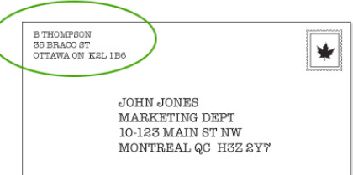
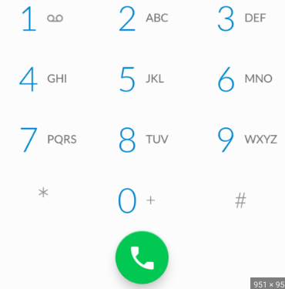

What catfishes want
Money
love
Phone number
Personal information
Address

Slide 5

Warning signs
.not a lot of photos
.asking for money
.not a lot of information
This Photo by Unknown author is licensed under CC BY-SA.

Slide 6

What to do
Block them on all websites
Report them
If you know the person they are trying to be, call them to check.
Never meet anyone you meet online!

