Slide 1



Monitoring Committee Feedback
July 2024

Slide 2
Mathematics & Numeracy Focus
Target 1: To monitor, review and evaluate impact of MN Progression Model and LPS Learning Projects across the school, making amendments where required, ensuring it meets the needs of all learners, our community and Curriculum for Wales .

Slide 3
Mathematics & Numeracy Focus
To help us monitor Target 1 of our Action Plan, we have used these questions and looked at examples of work from Reception, Year 2, Year 4 and Year 6.
Are numeracy tasks linked effectively to the Learning Projects? Do numeracy tasks offer development of skills across the curriculum? Are numeracy skills developed around Learning Project tasks?

Slide 4
Are numeracy tasks linked effectively to the learning projects?
Progression Step 1 (Reception)
The children ‘discovered’ dinosaur footprints in the yard and then had to measure them to work out who they belonged to.
The children had to create their own dinosaur using 2D shapes.
The children used their problem-solving skills to make sure that all the dinosaur eggs could fit in the nests.

Slide 5
Do numeracy tasks offer skill development across the curriculum?
Progression Step 1 (Reception)
Science - The dinosaur egg task was linked to their knowledge of life cycles.

Slide 6
Are numeracy skills developed around project tasks?
Progression Step 1 (Reception)
Maths lessons on measuring were taught before the dinosaur footprint experience.
Maths lesson on sorting before children used these skills in the enhanced provision (photos on website).

Slide 7
Are numeracy tasks linked effectively to the learning projects?
Progression Step 2 (Year 2)
Children had to explore visitor numbers and suggest ways of increasing visitor numbers at Penllergare Woods.

Slide 8
Do numeracy tasks offer skill development across the curriculum?
Progression Step 2 (Year 2)
Literacy – Children used their reading & research skills to complete the visitor task.

Slide 9
Are numeracy skills developed around project tasks?
Progression Step 2 (Year 2)
Addition and subtraction lessons completed in build-up to task.
Lessons on mental addition and subtraction of 2-digit numbers.
Construct block graphs and bar charts, days of the week, counting in 2’s – these skills taught directly through topic tasks.

Slide 10
Are numeracy tasks linked effectively to the learning projects?
Progression Step 3 (Year 4)
Children had to record and interpret data based on River Ilston.
Children carried out calculations to stock a Tudor shop for a voyage.

Slide 11
Do numeracy tasks offer skill development across the curriculum?
Progression Step 3 (Year 4)
Science & Literacy – Children used their reading skills and knowledge of species to complete their data tasks.
Humanities and Health & Wellbeing – Many skills from these areas covered.

Slide 12
Are numeracy skills developed around project tasks?
Progression Step 3 (Year 4)
Mode and median introduced in maths lesson and then developed through topic data task.
Problem solving, 4 operations taught before and after Tudor Voyage task.

Slide 13
Are numeracy tasks linked effectively to the learning projects?
Progression Step 3 (Year 6)
Children considered the impact of rationing in WWII through weekly and monthly budgeting for food shopping.
Researched Swansea Blitz through data handling work.
They used local maps when completed work on bearings.
They used data on local butterflies to prove theories of adaptations.

Slide 14
Do numeracy tasks offer skill development across the curriculum?
Progression Step 3 (Year 6)
Humanities – Map skills were needed to complete their bearings task.
Humanities & Literacy – The data task on the Swansea Blitz required reading and research skills and also history skills.
Health & Wellbeing and Humanities - The rationing task covered many skills from these areas.

Slide 15
Are numeracy skills developed around project tasks?
Progression Step 3 (Year 6)
Addition and subtraction (money) lessons completed in build-up to rationing task.
Angle lessons completed in build-up to bearings task.
Data task – graphs, pie charts, etc. – skills taught directly through topic.

Slide 16
Mathematics & Numeracy Focus
Target 2: Launch and manage new LPS Entrepreneurial Projects across the school.

Slide 17
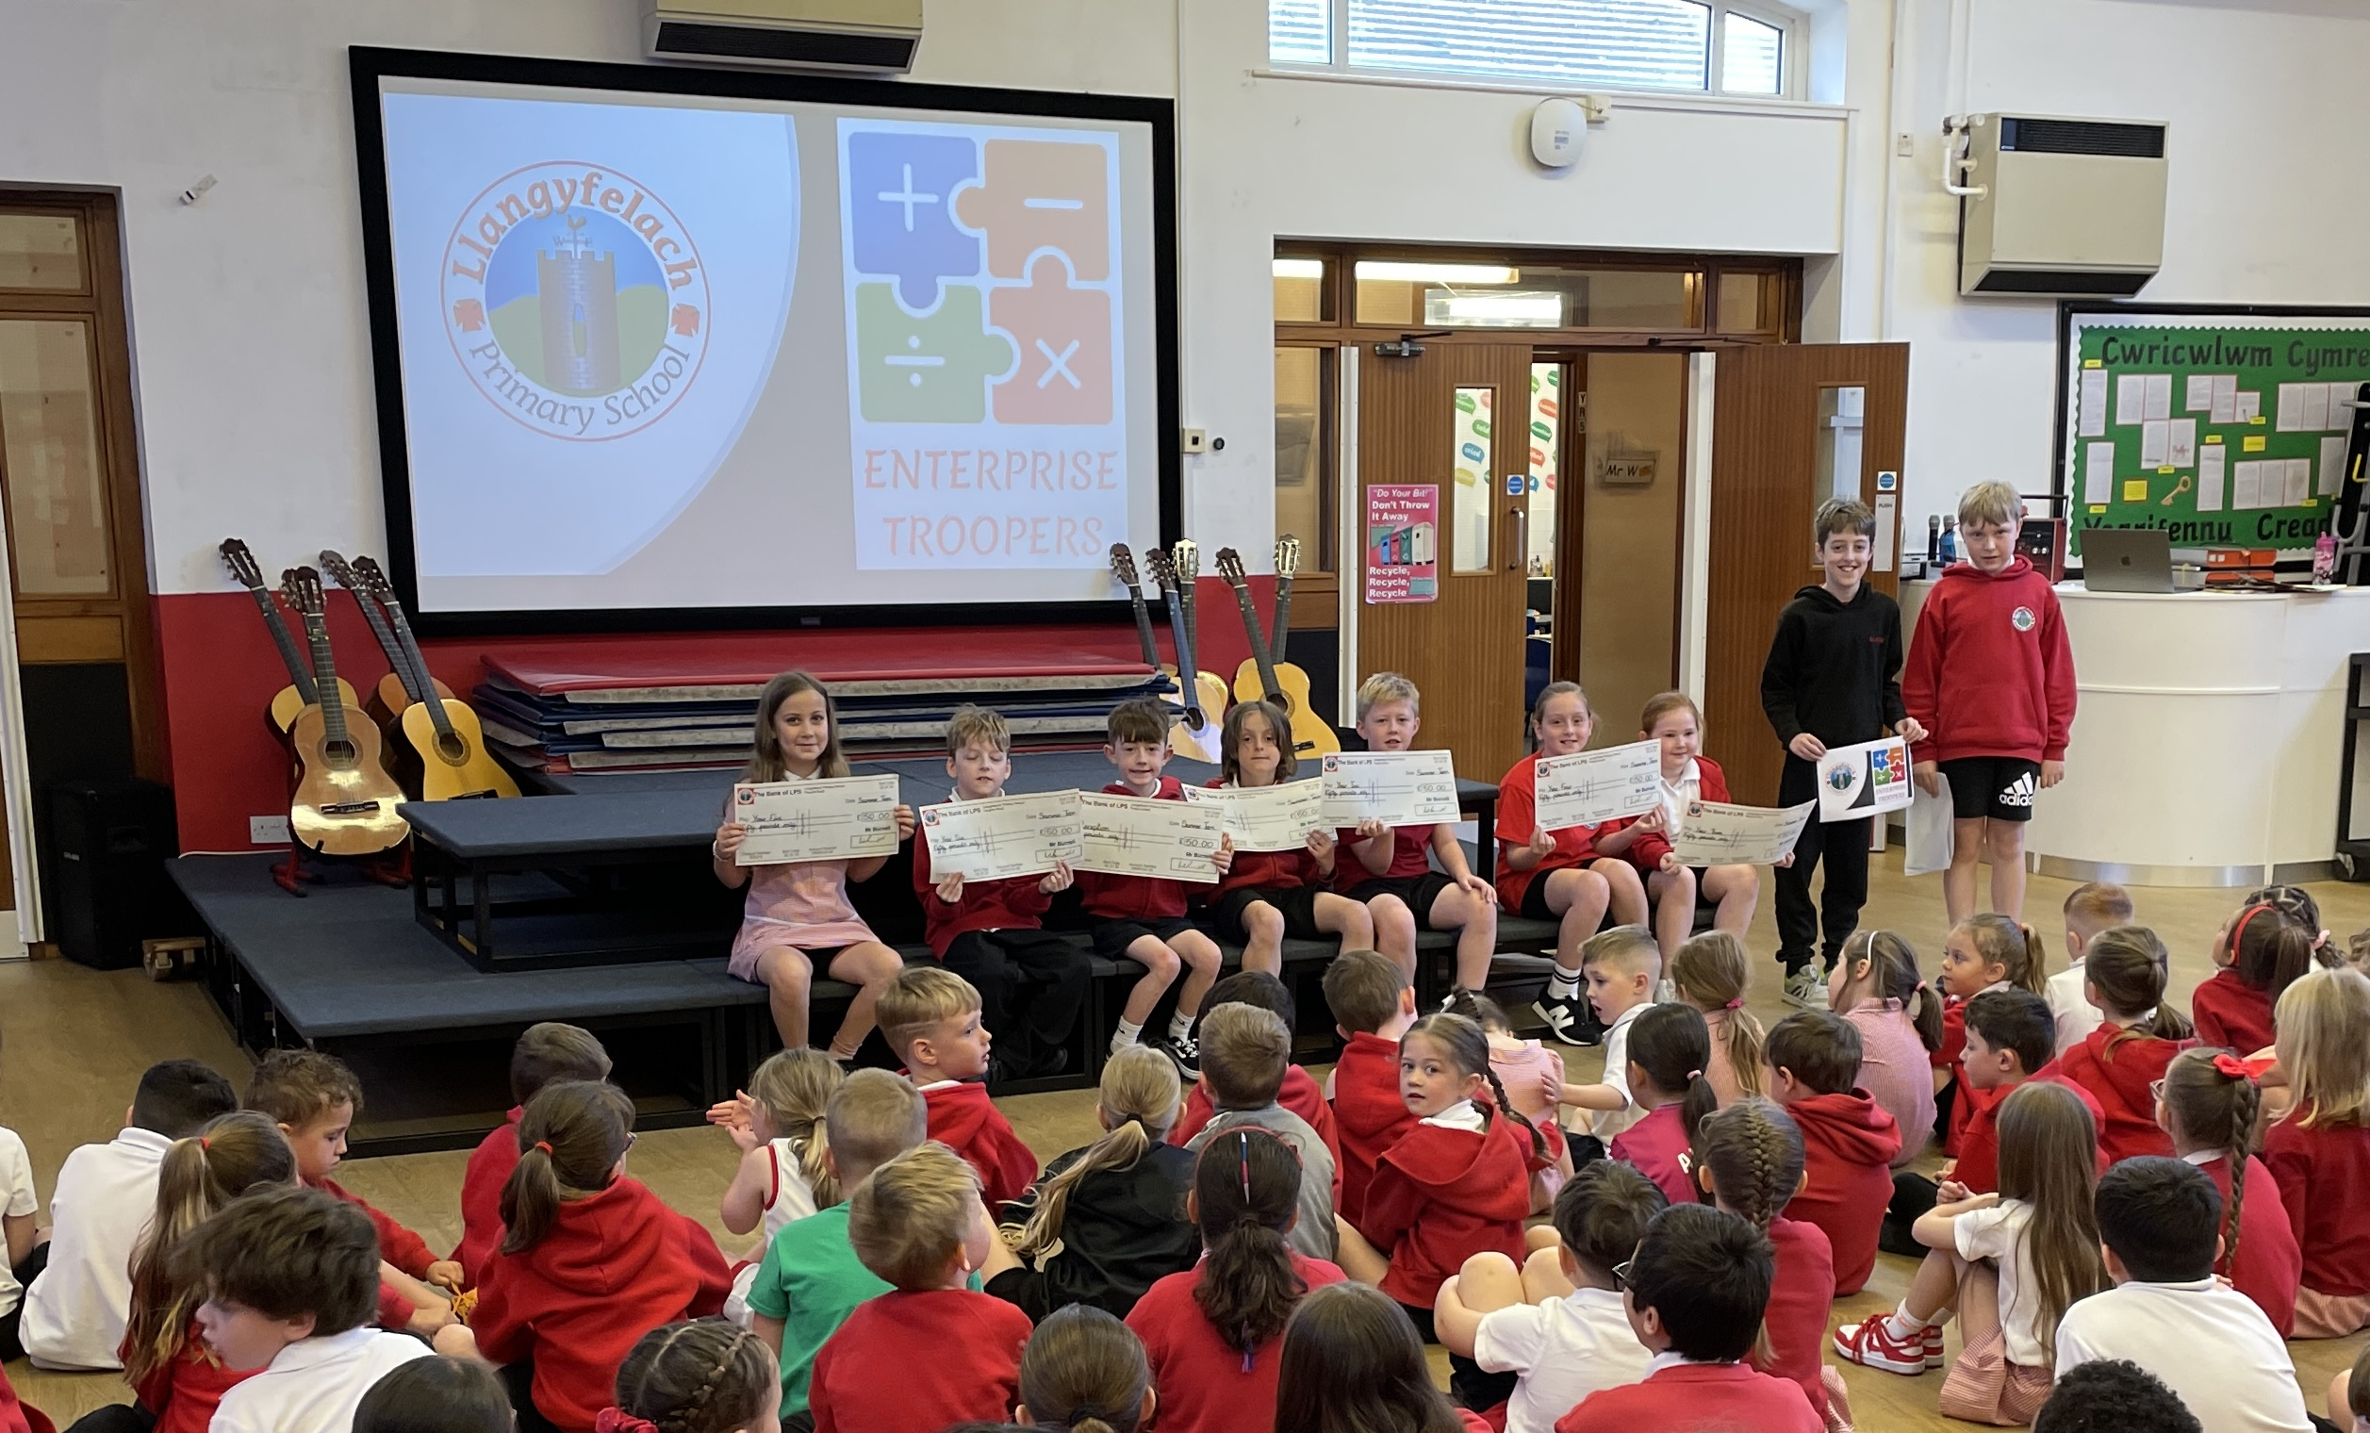
Target 2: Launch and manage new LPS entrepreneurial projects across the school
We launched the projects in an assembly on 6th June.

Slide 18
Target 2: Launch and manage new LPS entrepreneurial projects across the school
Each class was set the task to prepare to present a business plan to the Enterprise Troopers in assembly the following week.
If they presented a sensible business plan, they would be presented with an LPS cheque for £50.

Slide 19
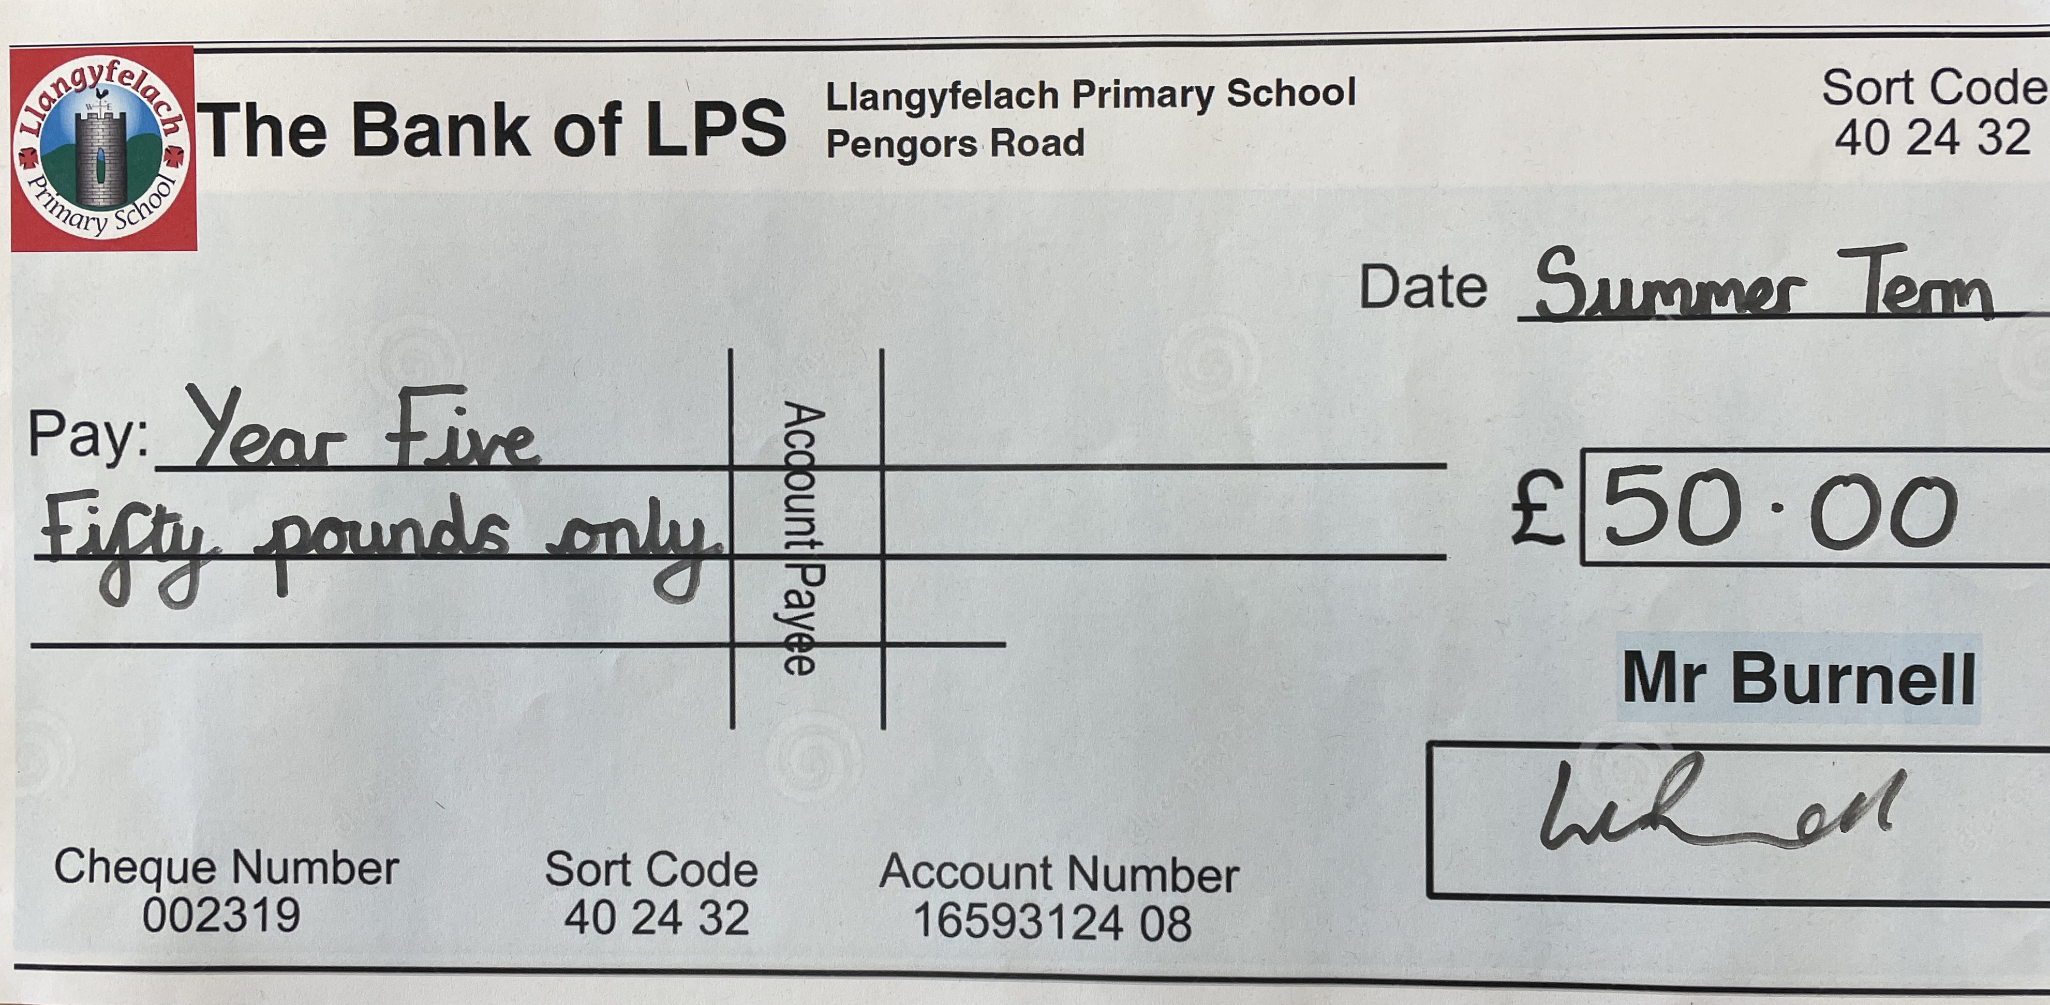
Target 2: Launch and manage new LPS entrepreneurial projects across the school

Slide 20
Target 2: Launch and manage new LPS entrepreneurial projects across the school
We decided that all classes had a sensible business plan and gave them all £50.
In order to successfully complete the project they must:
Research products so they know how to advertise and how much to charge
Decide on an advertising campaign
Calculate the profit or loss from their project
Identify ways to improve their business

Slide 21
Target 2: Launch and manage new LPS entrepreneurial projects across the school
The Enterprise Troopers will judge each class and decide who wins the prize. We will consider which class:
Makes the most profit
Has the most sustainable business
Has the most reflective and improved business model
You can see examples of work on the projects so far by visiting the class pages on the LPS website.

Slide 22
Mathematics & Numeracy Focus
Target 3: Develop whole school approach to developing mental processes and times table knowledge.

Slide 23
Target 3: Develop whole school approach to developing mental processes and times table knowledge.
New Mental Maths scheme introduced in January 2024.
PVG launched in their classes (22-1-24).
PVG also promoted weekly sessions on J2e Blast to develop times table knowledge.

Slide 24
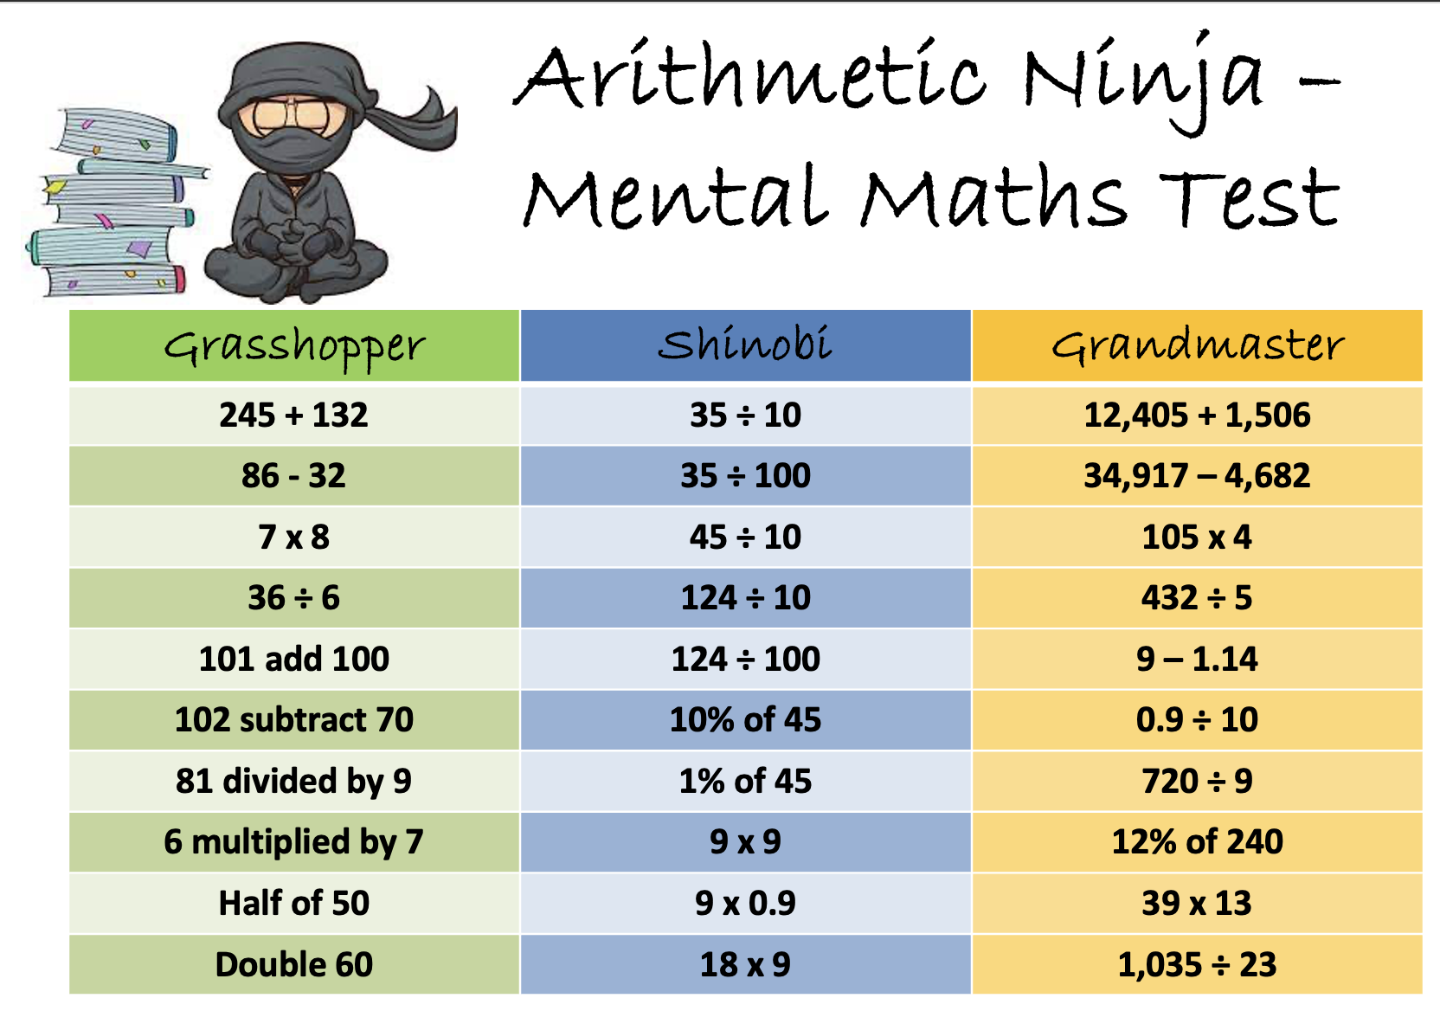
Year 6 approach to testing

Slide 25
Target 3: Develop whole school approach to developing mental processes and times table knowledge.
All classes have improved their average weekly score.
Pupil Questionnaire from Y2 – Y6 showed that:
  78% of pupils said their confidence in using mental maths has improved
  72% of pupils said that they were confident in learning their times tables.

Slide 26
Mathematics & Numeracy Focus
 | Average score before scheme | Average score after scheme
Year 2 | 4.9 | 6.8
Year 3 | 7.1 | 8.1
Year 4 | 4.6 | 6.2
Year 5 | 6.8 | 7.6
Year 6 | 7.8 | 9.1

Slide 27
Monitoring Committee Feedback
July 2024

